Slide 1
Federal 1040 Overview

Slide 2
IRS Form 1040
Everyone files a 1040 or a version of the 1040 (1040A, 1040EZ, etc)
Split up into 4 general areas
Taxpayer information
Income
Taxes & Credits
Payments/Refunds Due and Signature
Notes:
Post a copy of the 1040 on the web site so that students can print it or look at it full screen.

Slide 3
Taxpayer Information
Includes
Personal information for taxpayer & spouse
Presidential election campaign question
Filing status
Exemptions (including Dependents)
Input into TaxWise on the Main Information Sheet

Slide 4
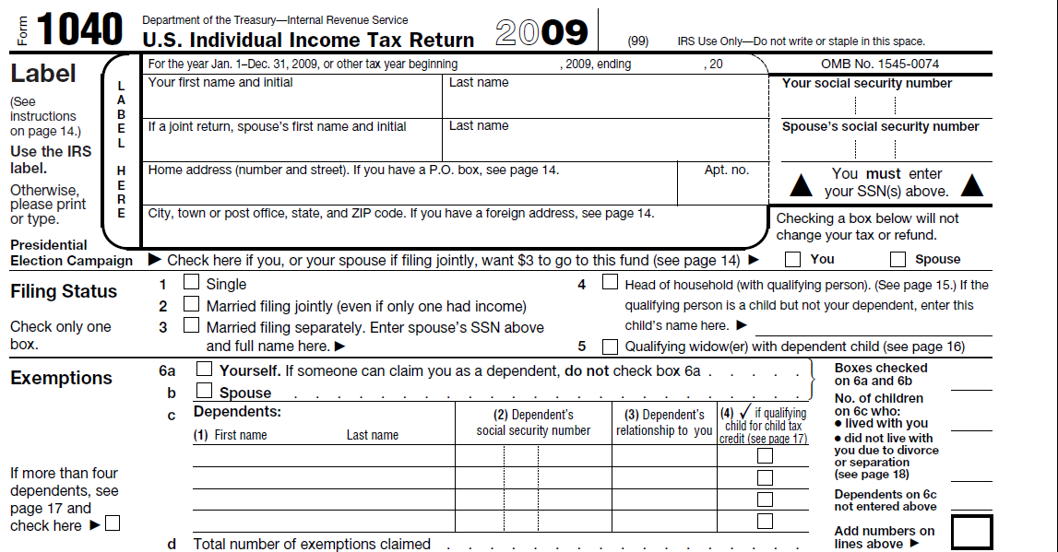
Form 1040 Page 1 TP Information
Personal Information

Slide 5
Form 1040 Page 1 TP Information
Presidential Election Campaign

Slide 6
Form 1040 Page 1 TP Information
Filing Status

Slide 7
Form 1040 Page 1 TP Information
Exemptions (including Dependents)

Slide 8
Income
All sources of income included in this section
Income derived from various tax forms usually issued by employer, financial institution, government agency, etc
Information from tax forms and client interview entered into the respective form or worksheet in TaxWise
TaxWise puts the appropriate values into the 1040
Adjustments to income included in this section
Final line on page is “Adjusted Gross Income”

Slide 9
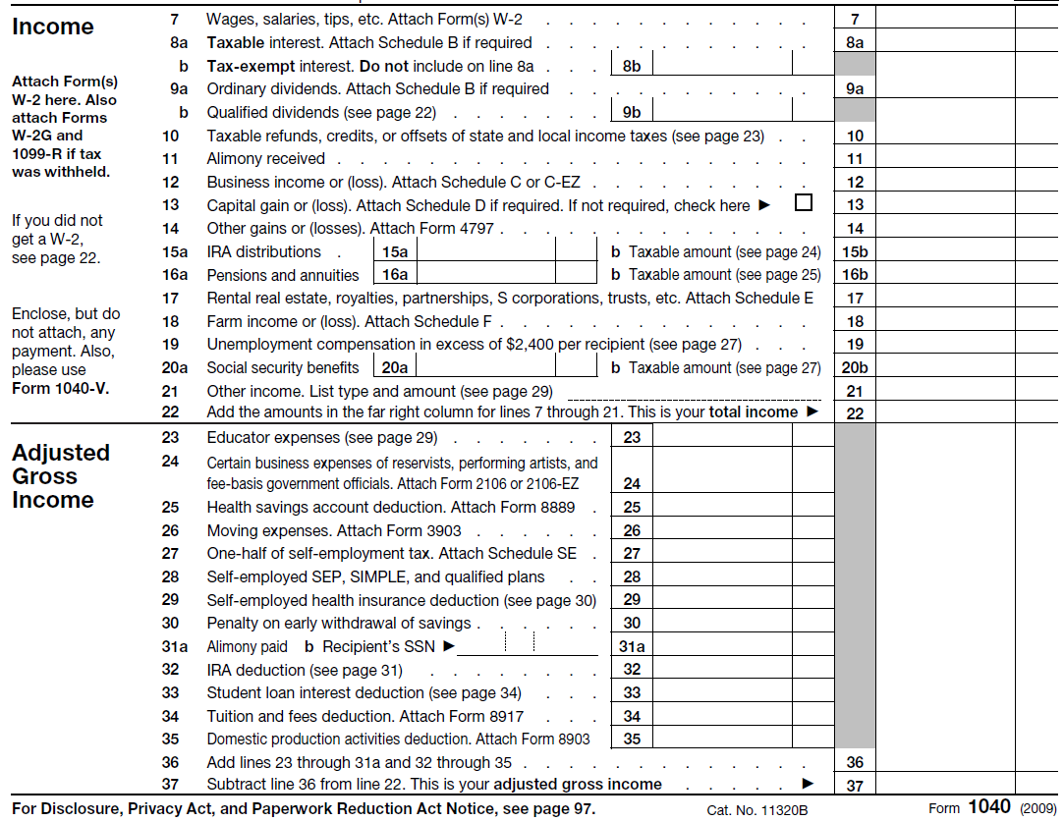
1040 Page 1 Income
Income

Slide 10
1040 Page 1 Income
Adjustments

Slide 11
1040 Page 1 Income
Adjusted Gross Income (AGI)

Slide 12
Taxes & Credits Page 2
Taxable Income
+ Start with “Adjusted Gross Income”
- Deduct Itemized or Standard Deduction
- Deduct Personal Exemptions
= Arrive at “Taxable Income”
Calculate Tax on “Taxable income”
Total Tax
+ Start with Calculated Tax on Taxable Income
+ Add Alternative Minimum Tax (Out of Scope)
- Deduct non-refundable tax credits
+ Add other taxes
= Bottom line is “Total Tax”
Notes:
Discuss the difference between refundable and non-refundable credits

Slide 13
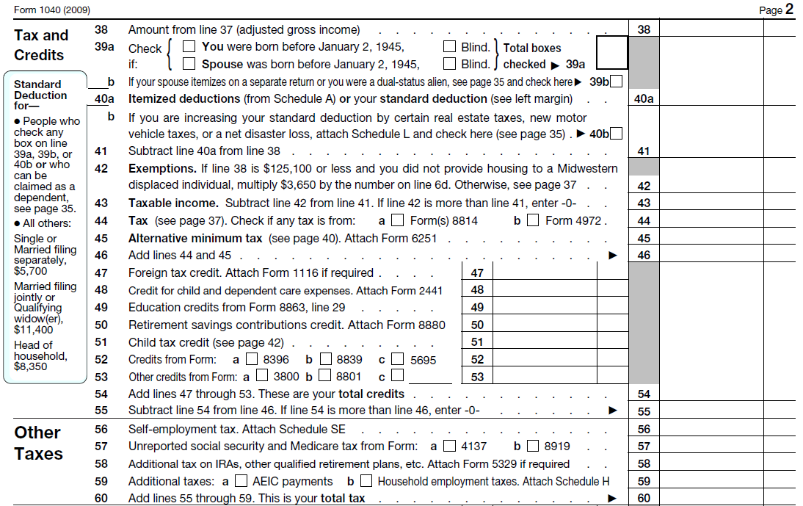
1040 Page 2 Taxes & Credits
Adjusted Gross Income (AGI)

Slide 14
1040 Page 2 Taxes & Credits
- Deduct Itemized or Standard Deduction

Slide 15
1040 Page 2 Taxes & Credits
- Deduct Exemptions

Slide 16
1040 Page 2 Taxes & Credits
= Arrive at Taxable Income

Slide 17
1040 Page 2 Taxes & Credits
Calculated Tax

Slide 18
1040 Page 2 Taxes & Credits
+ Add Alternative Minimum Tax (OOS)

Slide 19
1040 Page 2 Taxes & Credits
- Deduct Non-Refundable Credits

Slide 20
1040 Page 2 Taxes & Credits
+ Add Other Taxes

Slide 21
1040 Page 2 Taxes & Credits
= Bottom List is “Total Tax”

Slide 22
Payments/Refund/Owe/Sign
Refund / Owe
+ Start with “Total Tax”
- Apply tax withheld and estimated payments
- Deduct refundable credits
= Bottom line
A refund
You owe
Direct deposit information
Signature line

Slide 23
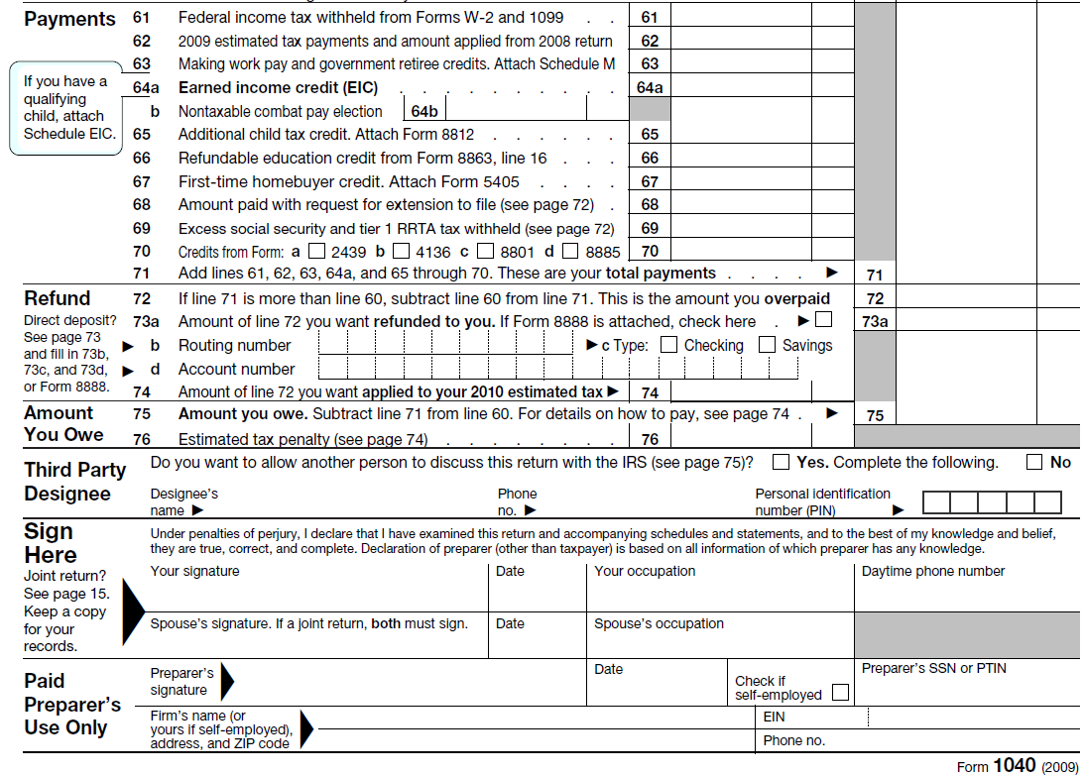
Payments/Refund/Owe/Sign
- Apply tax withheld and estimated payments

Slide 24
Payments/Refund/Owe/Sign
- Deduct refundable credits

Slide 25
Payments/Refund/Owe/Sign
= Bottom Line (A refund / You owe)

Slide 26
Payments/Refund/Owe/Sign
Direct Deposit information

Slide 27
Payments/Refund/Owe/Sign
Signature Line

